Slide 1
Linear Mixed Models
An Introduction
Alex Jones & Jeremy Tree

Slide 2
Structure
1
Morning lecture
2
Afternoon practical
3
Open surgery
~90 minutes
~ 90 minutes
Till late
- Some theory based content
Refreshing the GLM
Introducing the linear mixed model
Pros and cons of the hierarchical approach
Hands on and walkthrough analysis of a dataset in JAMOVI plus some exercises
Bring your own data and problems and we’ll get them ready

Slide 3
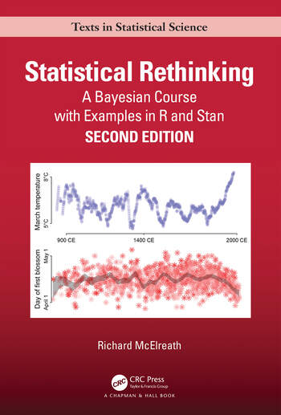
"Multilevel regression deserves to be the default form of regression."
— Richard McElreath, Statistical Rethinking
By the end of today, you will hopefully agree!
Mixed models seem exotic and intimidating at first glance
All they are is a linear regression that acknowledges the hierarchical or grouping structure that comes with most psychological data
Once you see the hierarchies you will wonder how you did without them!

Slide 4
Part 1 — Its Just A Linear Model (IJALM)
A refresher on the GLM

Slide 5
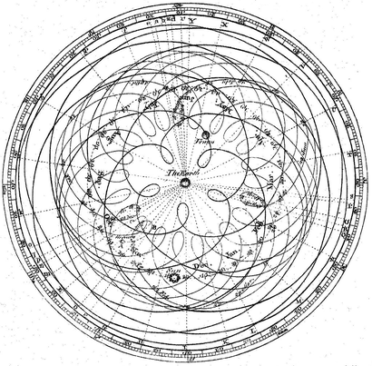
Scientists create models of the object of study
Models are a numeric representation of the theory of interest
Models make predictions which are compared against data, and are not needlessly complex

Slide 6
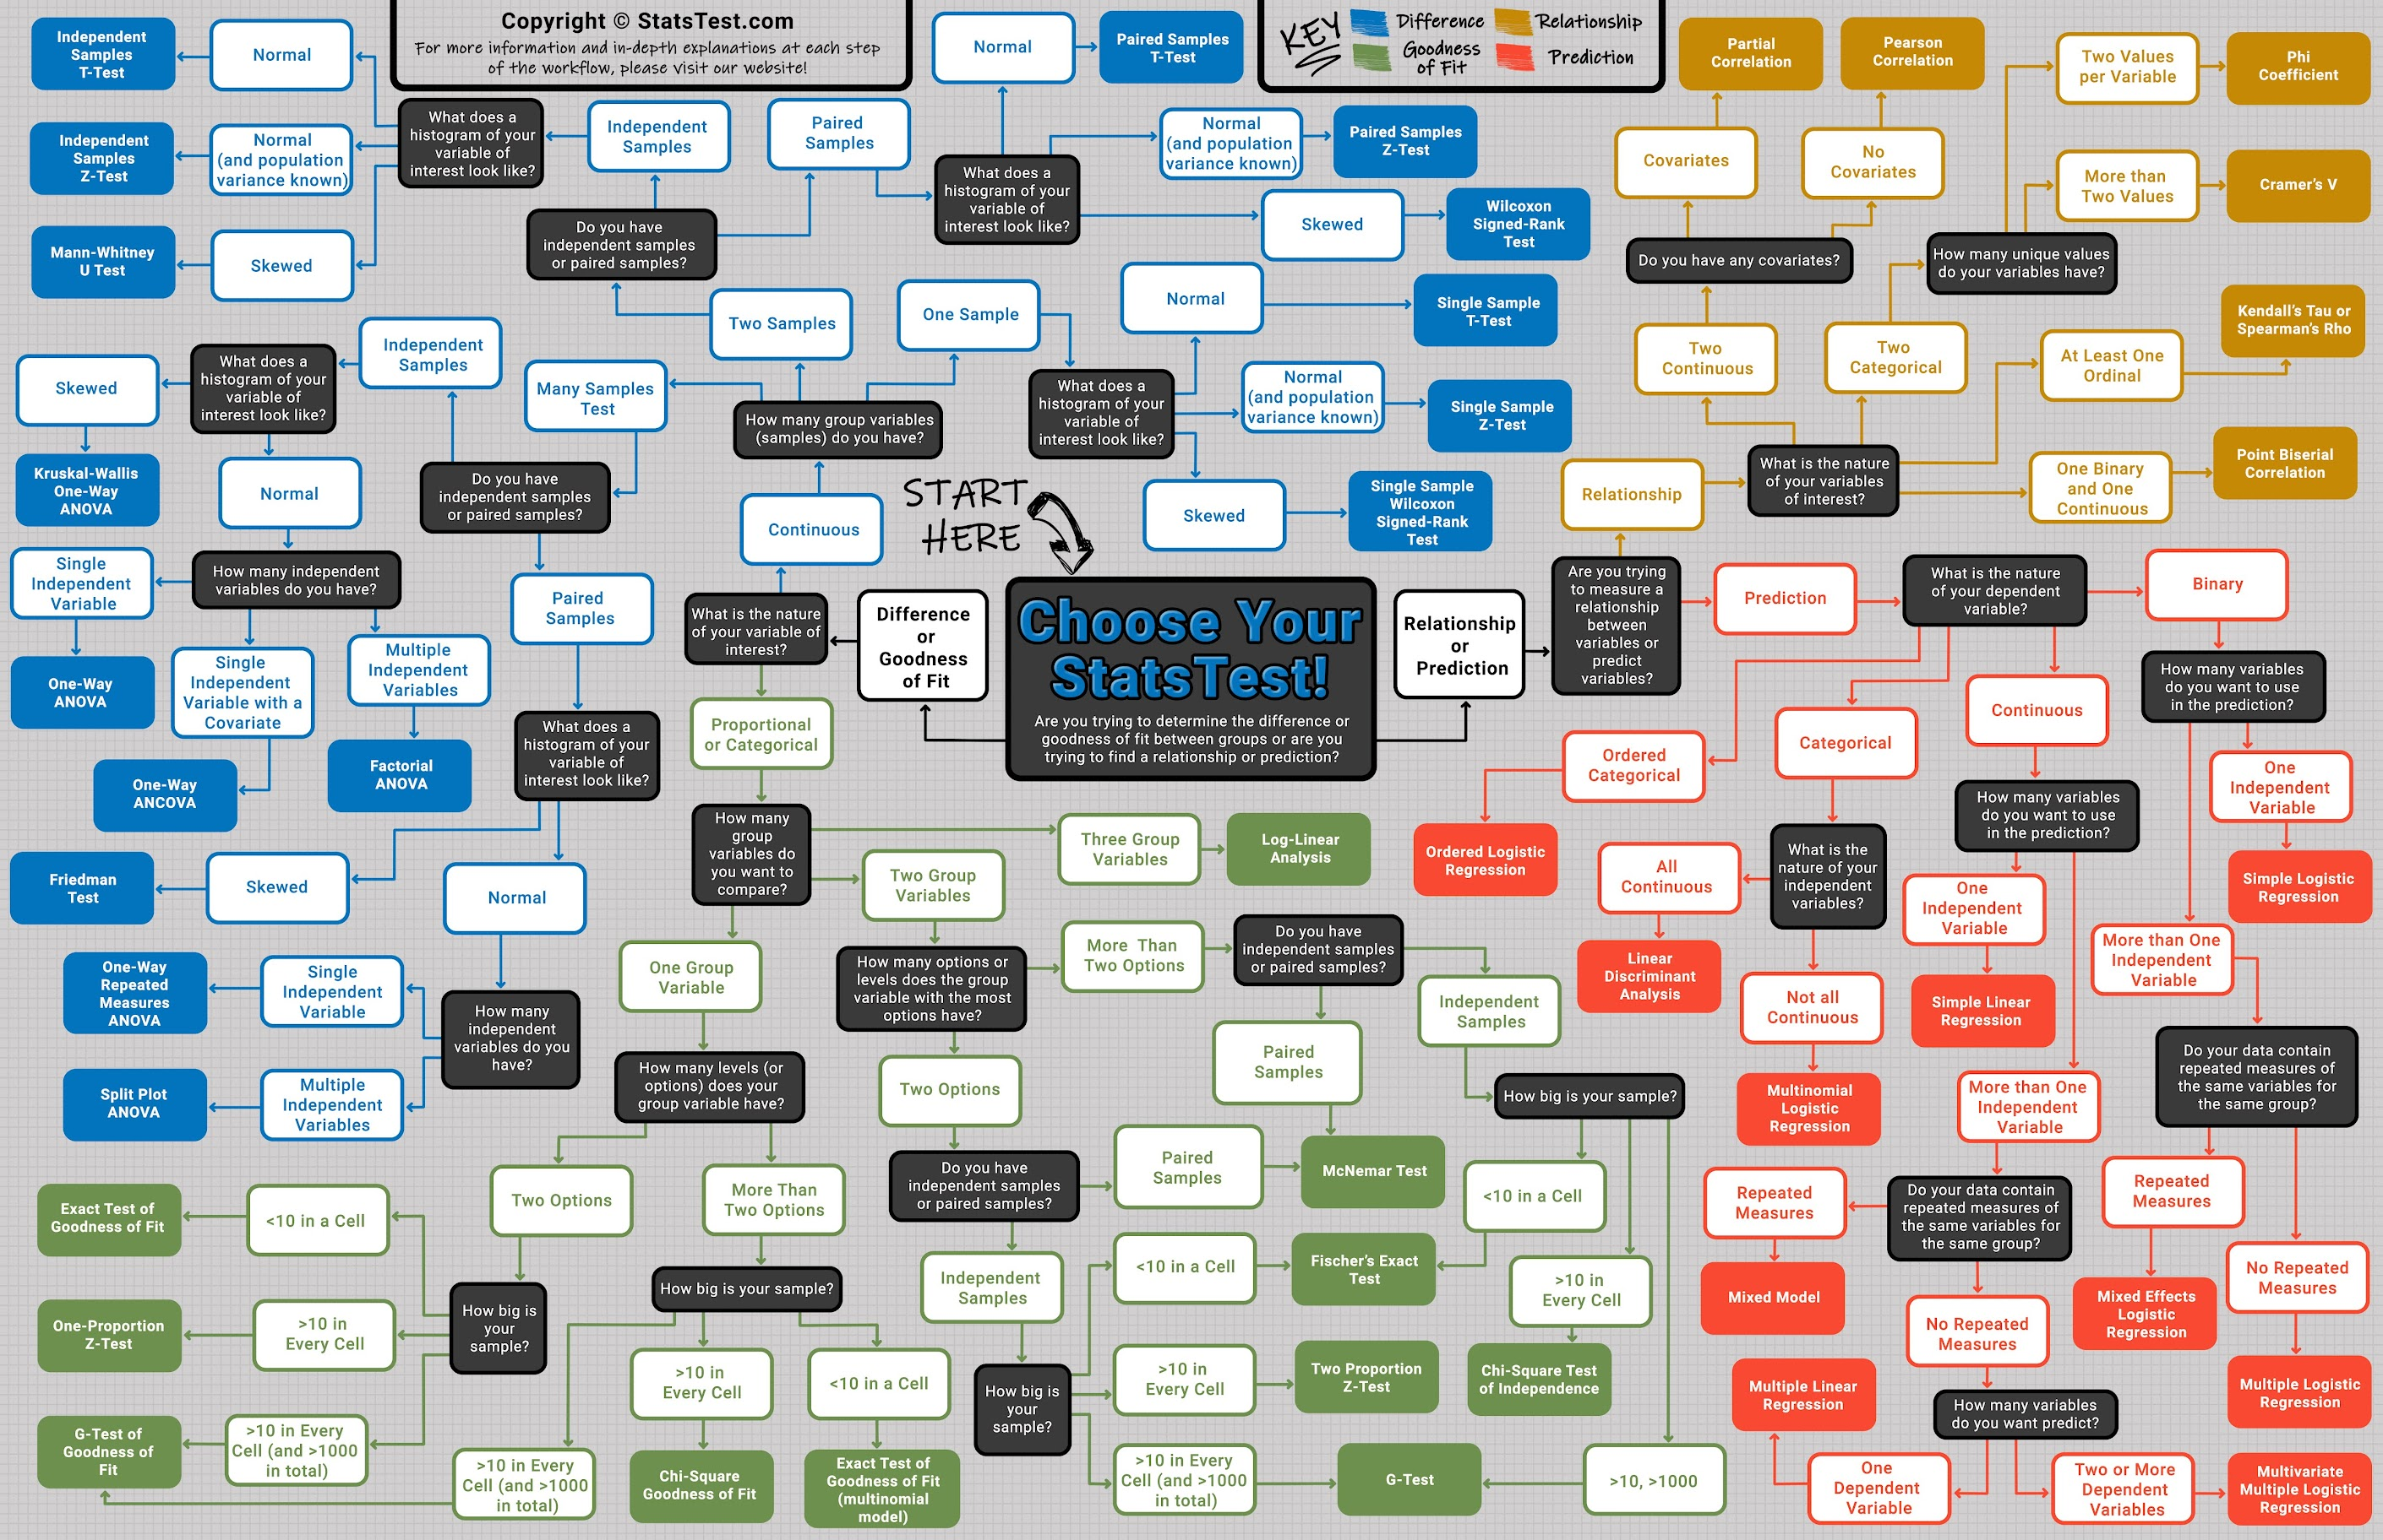
Psychology relies on statistical models, usually entirely implicitly
When we ”select a test” for our data, we are imposing a model that is a statement from us that we think ‘this is how this might work’
This is typically implicit, but we will make it explicit
Underneath almost all statistics in psychology is the general linear model
Psychologists typically have qualitative models – collections of organized findings, and their tests are indirect
We can be more explicit
Notes:
Now you only have to learn one thing, instead of many.

Slide 7
The fundamental theorem of statistical inference
Almost every analysis and design in psychology is an example of the general linear model!
If you know how to organise data and run a regression, you already have the building blocks of thinking in terms of models and not ‘tests’
Correlation, t-tests, ANCOVA and every-which-way ANOVA are all special cases of regression
Statistics no longer becomes a flowchart of arbitrary tests, and you can build models of the questions you are actually interested in
The mixed model is just an extension of these principles

Slide 8
A quick crash course in Wilkinson notation
The simple shorthand statisticians (and JAMOVI, and R, and Python) use to write models – it’s a good organising set of principles
y ~ 1
y is a function of nothing but its own mean – intercept only
y ~ 1 + x
y is a function of x — one predictor
y ~ 1 + x + z
y is a function of x and z — two predictors
y ~ 1 + x * z
y is a function of x and z and their interaction
y ~ 1 + x + (1 | g)
a random intercept for each level of g — coming later when we see mixed models

Slide 9

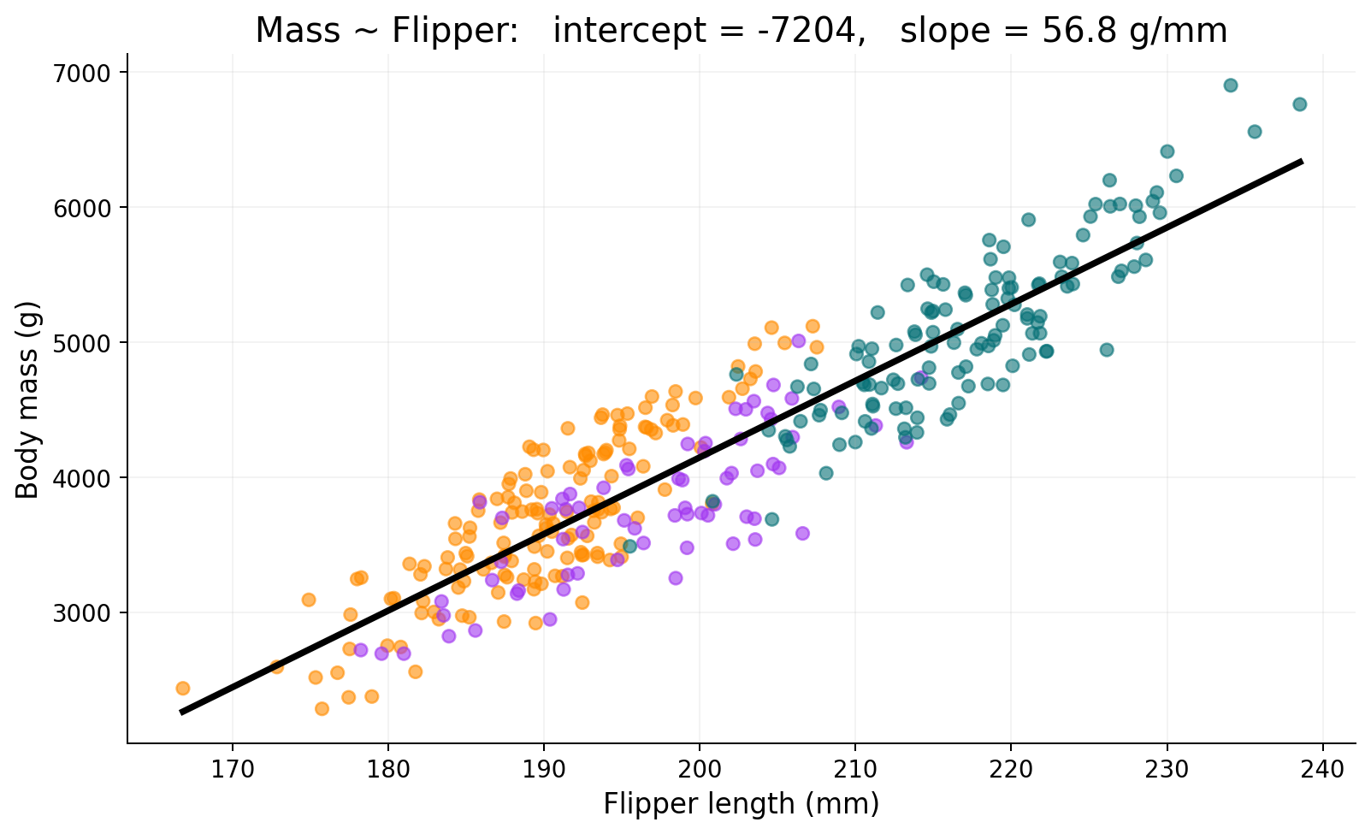
Regression Anatomy 101
INTERCEPT
The value of Y when every predictor is zero. Here, the predicted body mass of a penguin with a flipper of zero millimetres - this is silly but can make it mean something
SLOPE
The change in Y for a 1-unit increase in X, holding all other predictors constant. Here: each extra mm of flipper adds ~50 g of body mass.
y = β₀ + β₁x

Slide 10
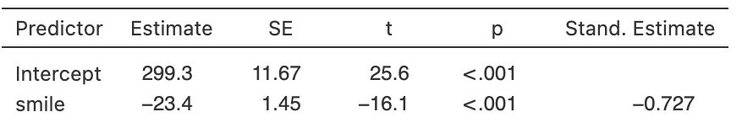
Altering variables — same model, different units
Altering your predictors or outcome changes what the key elements mean (intercept, slopes) but doesn’t alter the fit of the model
Alter data judiciously to make things interpretable!
Raw units
Mass ↑ ~50 g per mm of flipper (slope)
Intercept is -7204
Z-scored predictor
Mass ↑ ~860 g per 1 SD of flipper (slope)
Intercept is 4237g (mass when predictors are zero!)
Z-scored both
Mass ↑ 0.92 SD per 1 SD of flipper
Intercept is zero by definition
e.g. most software gives these options

Slide 11
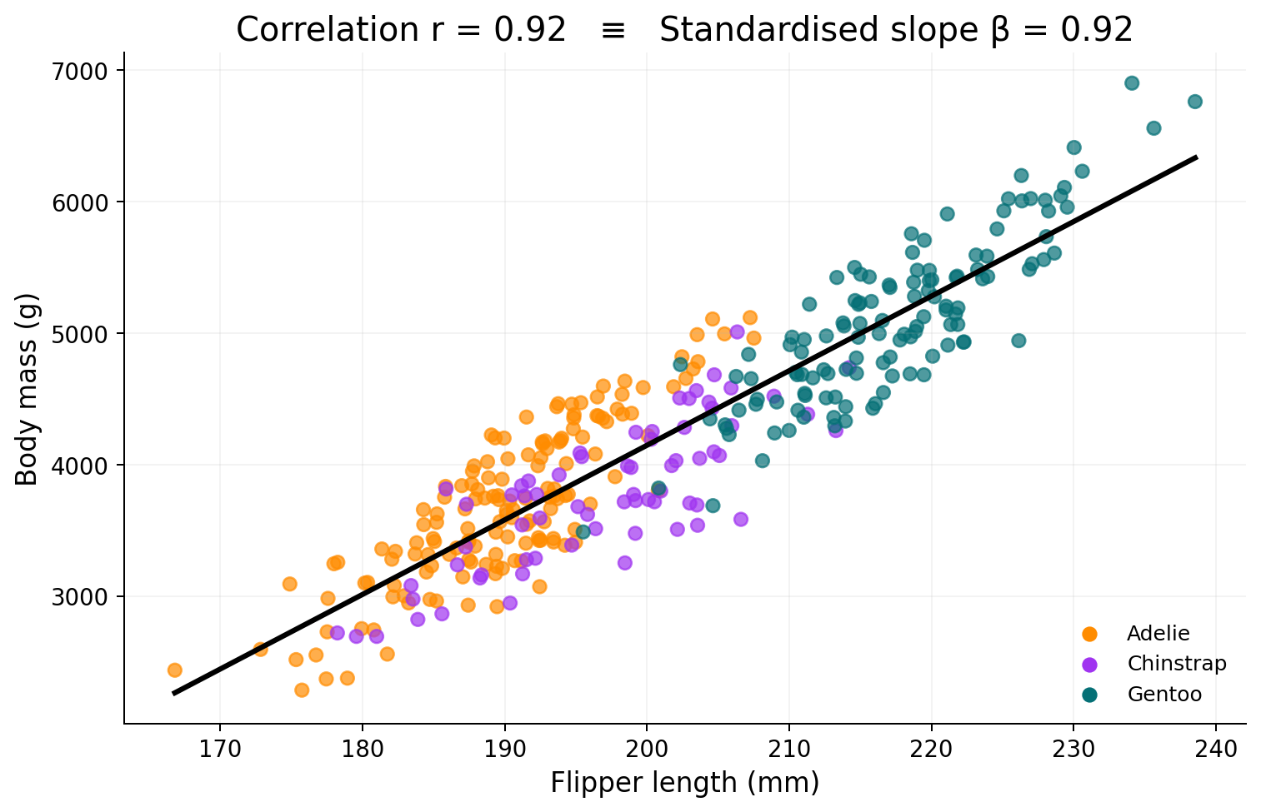
IJALM #1 — Correlation ≡ Standardised regression
What's going on?
A "correlation" is just the slope of a regression when both variables are z-scored.
It is exactly the same, including confidence intervals, p-values, etc
r = 0.92 means: a 1 SD increase in flipper length predicts a 0.92 SD increase in body mass

Slide 12
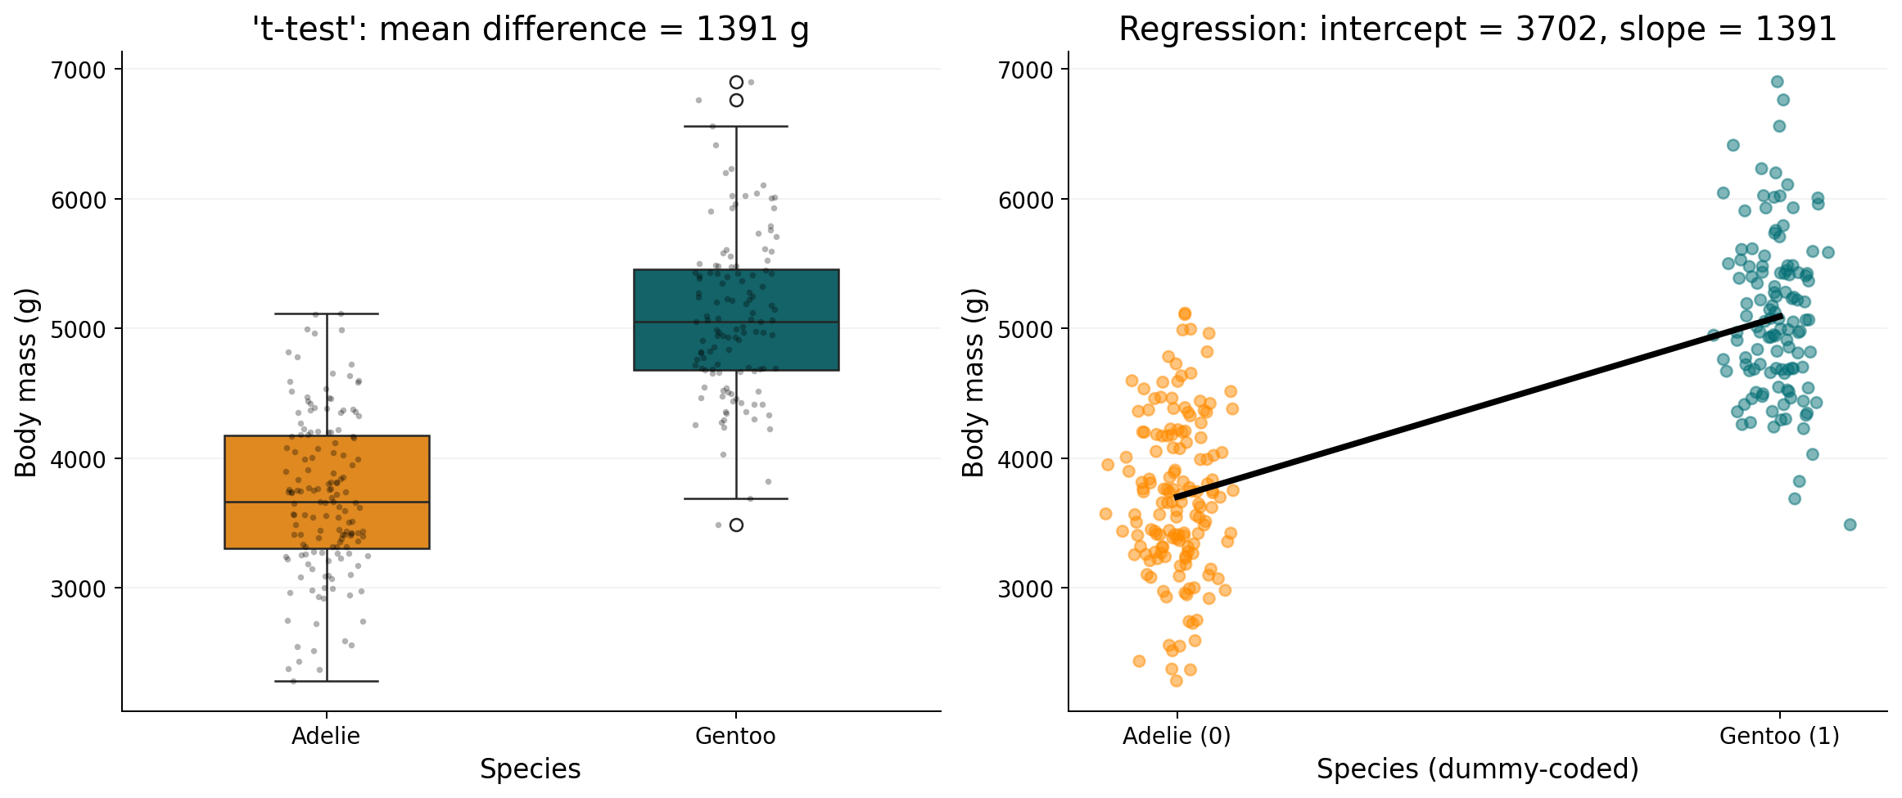
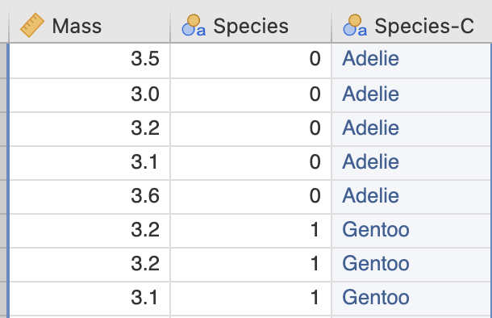
IJALM #2 — t-test ≡ Regression on a binary predictor
Code one group 0 and the other 1 – order does not matter
Run a regression. The intercept is the mean of group 0; the slope is the mean difference.
The 'difference between means' is just the slope! The t-test result and the regression result are numerically identical.

Slide 13
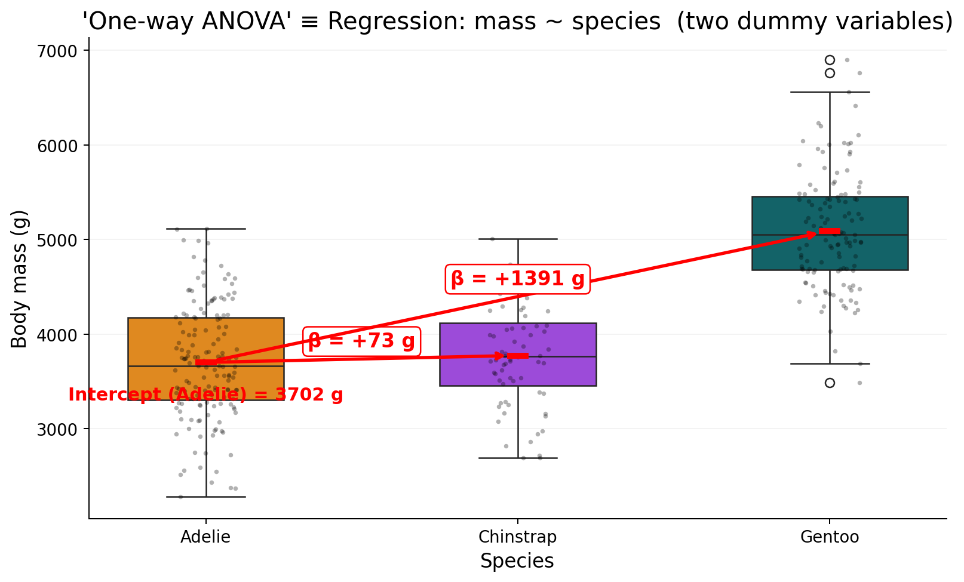
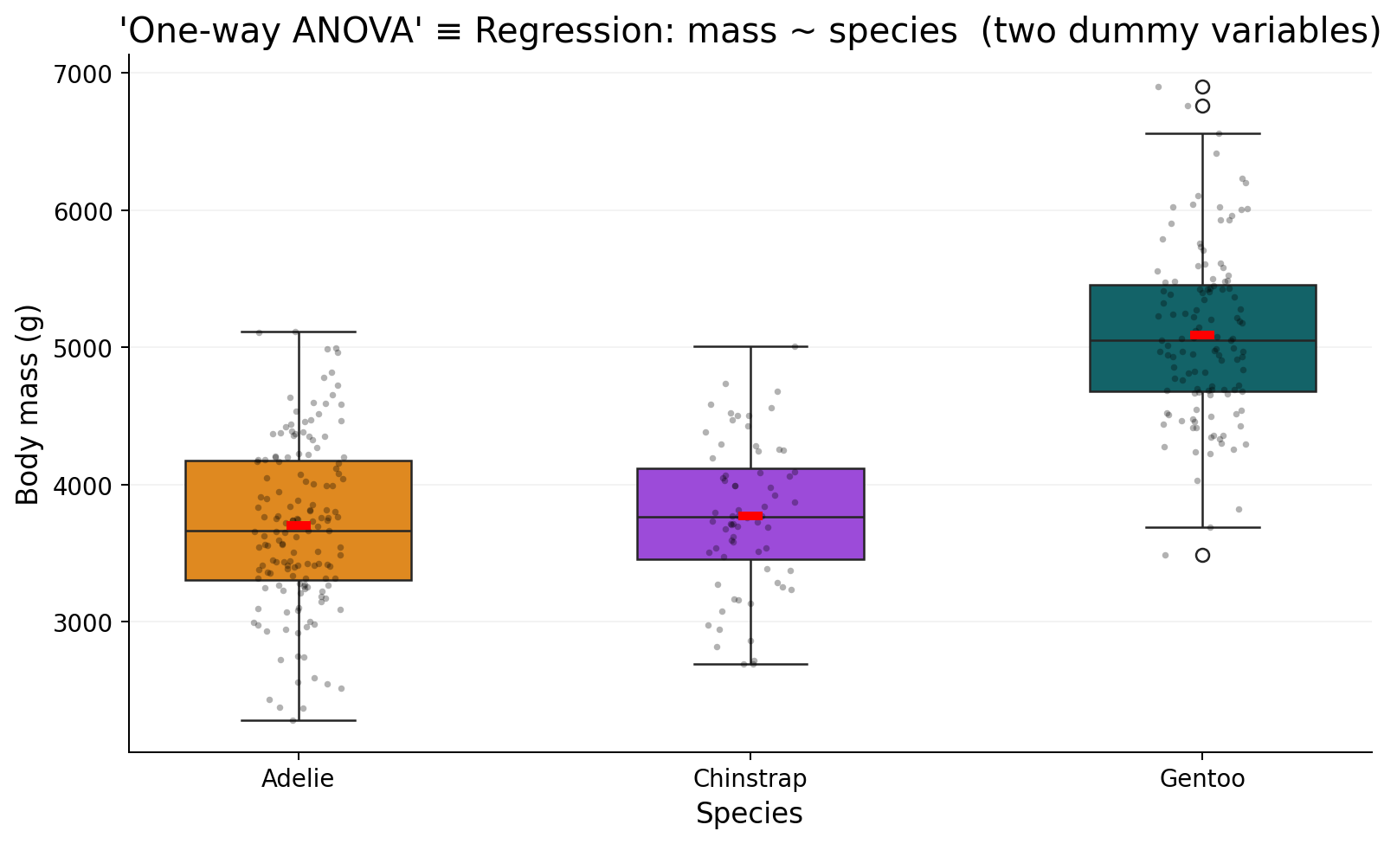
IJALM #3 — One-way ANOVA ≡ Dummy-coded regression
Species | Intercept | isChinstrap | isGentoo
Adelie | 1.0 | 0.0 | 0.0
Adelie | 1.0 | 0.0 | 0.0
Adelie | 1.0 | 0.0 | 0.0
… | … | … | …
Chinstrap | 1.0 | 1.0 | 0.0
Chinstrap | 1.0 | 1.0 | 0.0
… | … | … | …
Gentoo | 1.0 | 0.0 | 1.0
Gentoo | 1.0 | 0.0 | 1.0
Gentoo | 1.0 | 0.0 | 1.0
A categorical predictor with k levels becomes k−1 dummy (0/1) variables. The intercept is the reference group mean.
Each coefficient is the difference from that reference.
ANOVA tests whether at least one of those coefficients is non-zero.

Slide 14
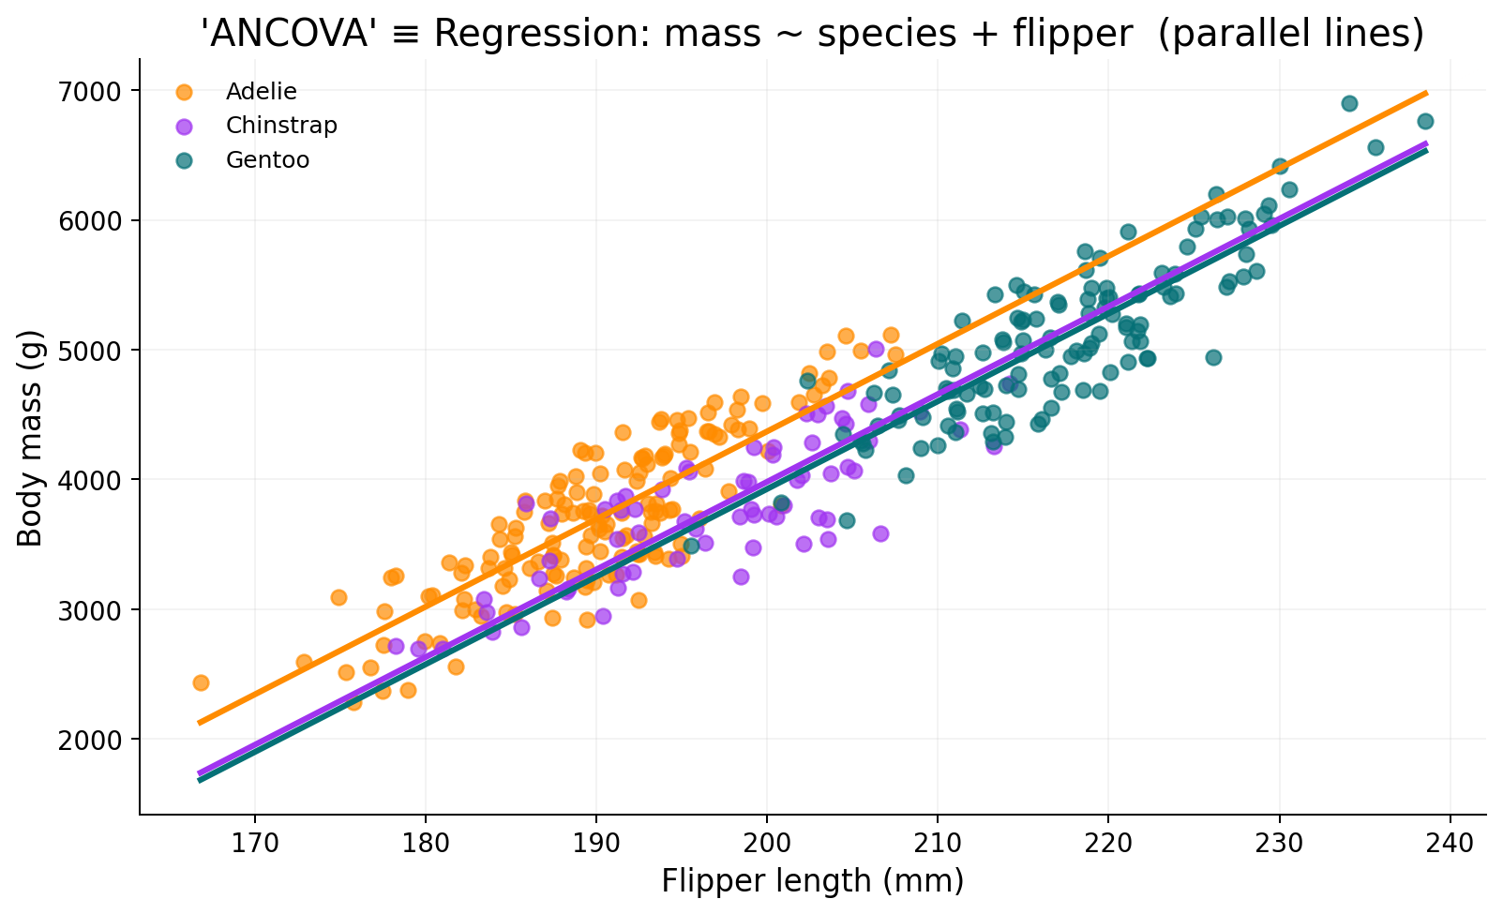
IJALM #4 — ANCOVA ≡ ANOVA + a continuous predictor
Add a continuous predictor (a "covariate") and you get parallel lines: one per group, all with the same slope.
The species coefficients now answer: do groups still differ once we account for flipper length?
Recall – coefficients/slopes mean the influence of the predictors holding all others constant. So including a predictor means

Slide 15
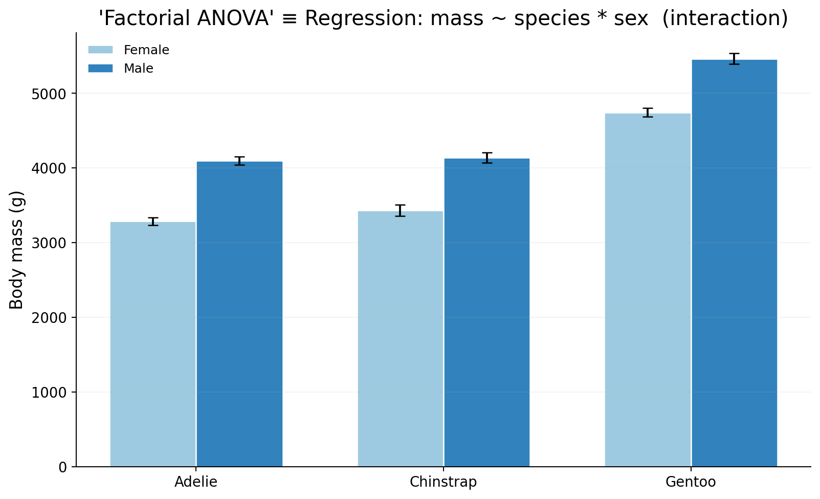
IJALM #5 — Factorial ANOVA ≡ Categorical interactions
Two categorical predictors and their product: y ~ species * sex. The interaction tests if the sex effect depends on species.
In Gentoo, the male–female gap is much larger — that's the interaction, and it's just one more coefficient in the model.

Slide 16
IJALM #5 — Factorial ANOVA ≡ Categorical interactions
species | sex | Intercept | isChinstrap | isGentoo | isMale | isChinstrap × isMale | isGentoo × isMale
Adelie | Male | 1 | 0 | 0 | 1 | 0 | 0
Adelie | Female | 1 | 0 | 0 | 0 | 0 | 0
… | … | … | … | … | … | … | …
Chinstrap | Female | 1 | 1 | 0 | 0 | 0 | 0
Chinstrap | Male | 1 | 1 | 0 | 1 | 1 | 0
… | … | … | … | … | … | … | …
Gentoo | Female | 1 | 0 | 1 | 0 | 0 | 0
Gentoo | Male | 1 | 0 | 1 | 1 | 0 | 1
Two categorical predictors and their product: y ~ species * sex. The interaction tests if the sex effect depends on species.
In Gentoo, the male–female gap is much larger — that's the interaction, and it's just one more coefficient in the model.

Slide 17
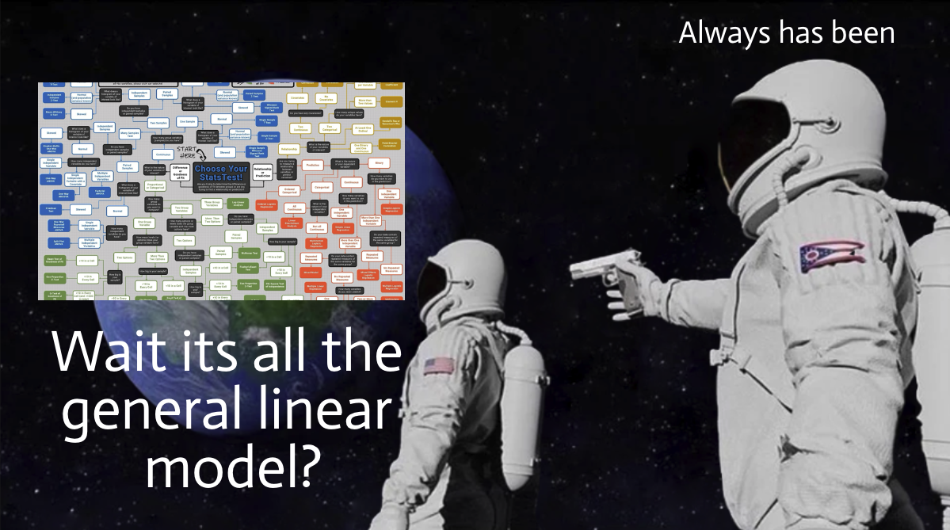
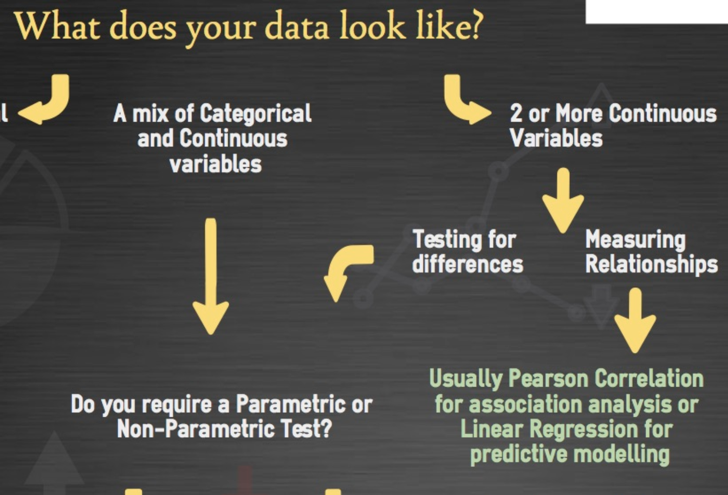
The 'which test?' flowchart…
Alex
Student

Slide 18
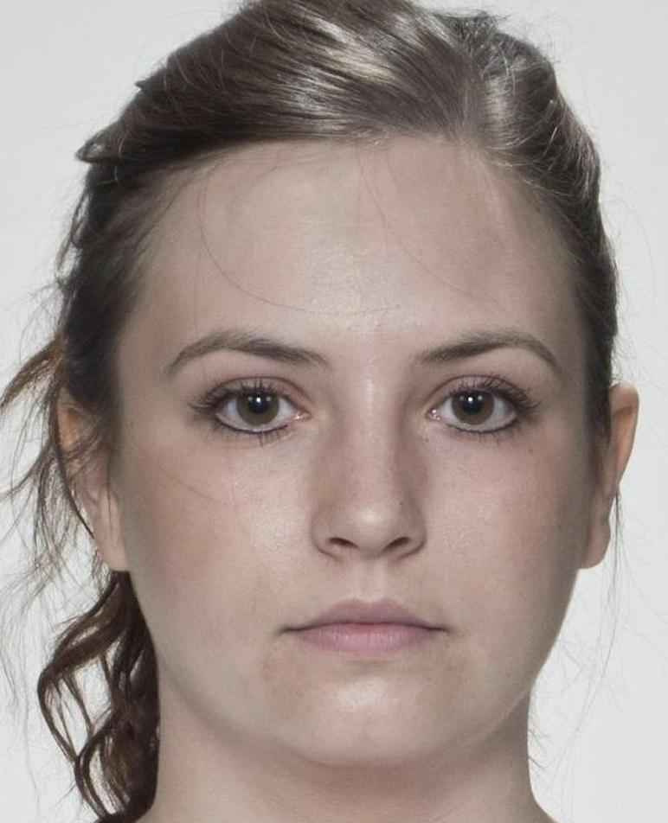

We no longer need tests, and we can start modelling
We should always be concerned with the ‘data generating process’ – how has nature put this data in front of us? What combination of variables influence the outcome?
Then: write that down as a model, and the test comes “for free”.
We usually operate in reverse – we have a dataset and we end up press-ganging it into the usual flowchart machinery, making decisions along the way and aggregating over levels of data to make it work, losing critical information and making assumptions we’re not aware we are making
e.g. how attractive is this face? Multiple raters provide ratings of multiple faces
If we average over participants, each faces data is ‘equivalent’ as we destroy rater variation
But one face splits opinion more than the other!
M = 3.92
SD = 1.43
M = 3.92
SD = 1.72

Slide 19
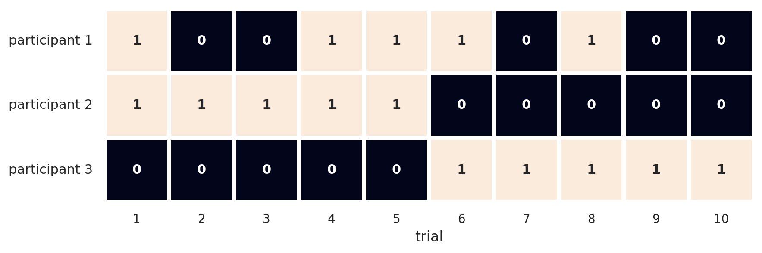
We no longer need tests, and we can start modelling
We should always be concerned with the ‘data generating process’ – how has nature put this data in front of us? What combination of variables influence the outcome?
Then: write that down as a model, and the test comes “for free”.
We usually operate in reverse – we have a dataset and we end up press-ganging it into the usual flowchart machinery, making decisions along the way and aggregating over levels of data to make it work, losing critical information and making assumptions we’re not aware we are making
Accuracy on a face test
Sum score is 5 for all
Are they really equivalent?
Trials 6-10 are designed to be harder
Trials 1-5 are designed to be easier

Slide 20
The catch — independence of errors
The GLM assumes the residuals (true – predicted) are independent of each other.
Almost any realistic psychology dataset breaks this assumption:
• Each participant gives many trials in an experiment.
• Each pupil sits in a class, which sits in a school.
• Each patient is seen by a clinician inside a hospital.
• Each rating you collect is one of many about the same target.
When errors are not independent, standard errors are wrong, p-values are wrong, and your inference is unreliable.
The field’s historic response to this has been to collapse a source of variation in order to make this assumption tractable, but it means we have missed out on a lot of inference, and we see only part of the story in our data

Slide 21
Break
~10 minutes

Slide 22
Part 2 — The Linear Mixed Model
The GLM, structured. Partial pooling. The sleep study, walked through.

Slide 23
What is a mixed model?
It is the GLM with one extra ingredient: random effects!
Everything we just covered applies to these models too
Distinctions in naming:
Fixed effects
Random effects
The new piece that solves the independence problem
Variation around the fixed effects, for each cluster or group in the data.
They exist to account for the non-independence of clustered data.
AKA “group-specific”
What we already know
Defined as the effect of a predictor across the whole population
These are the slopes and intercepts of the GLM
AKA population effects

Slide 24
Hierarchies are everywhere
Once you see them, you cannot un-see them.
Education
Healthcare
Pupils → classrooms → schools
Patients → clinicians → wards → hospitals
Experimental psych
Social
Trials → participants → labs
Individuals → families → neighbourhoods
Ratings research
Longitudinal
Ratings → raters × targets
Measurements → person → cohort

Slide 25
Benefits & costs
Benefits
Costs
• More accurate model of the data-generating process
• You can answer previously impossible questions (examples coming up)
• Estimates of cluster-level variability
• Graceful with missing or unbalanced data – the model doesn’t mind if some participants don’t complete everything
• Partial pooling: individuals and population learn from each other, and estimates are more robust
• More accurate model of the data-generating process! You have to think hard about your model structure, both fixed and random
• No canned recipe — every dataset is a new, small modelling problem
• Effect sizes (R²) are harder to define
• Power analysis has no closed form
• Coefficient interpretation gets harder as complexity grows

Slide 26
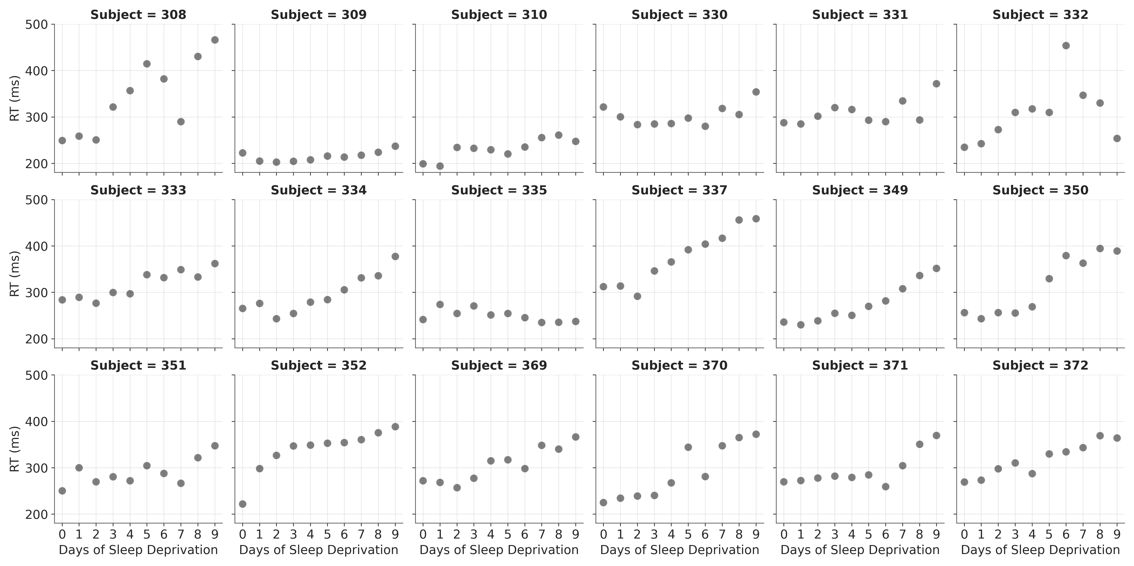
The sleep study
Belenky et al., 2003 — sleep restricted to 3 hours/night for 10 days.
18 participants · 10 days · reaction time on a vigilance task · How should we model this?

Slide 27
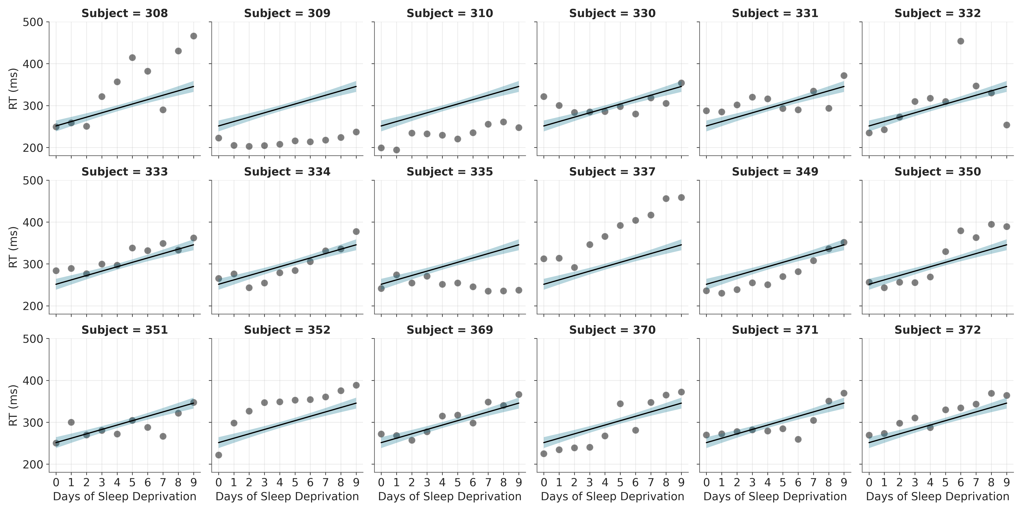
Option A — Complete pooling (a single GLM), ignore grouping
Reaction ~ 1 + Days
We simply ignore the dependence!
The same slope and intercept for everyone (we assume the effect of deprivation is the same, and that everyone has the same average RT)
Lots of data → tight (but wrong) confidence intervals

Slide 28
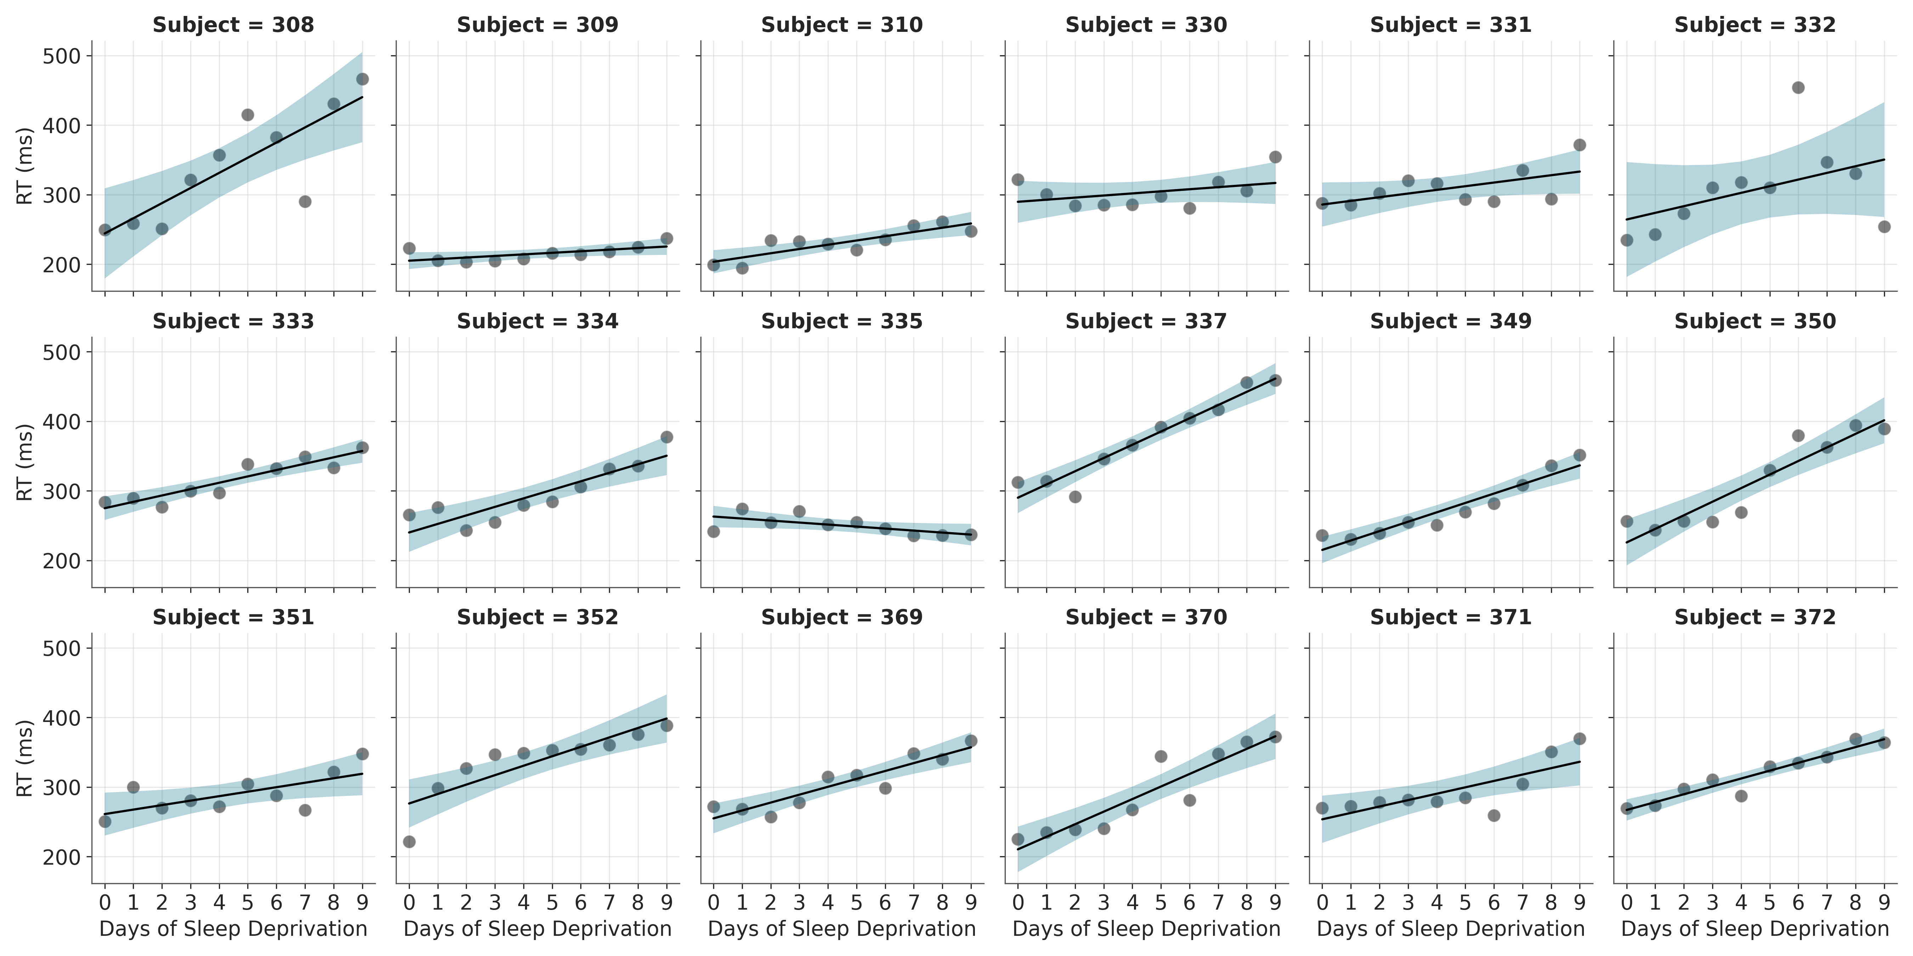
Option B — No pooling (one model per person)
lm per Subject
Fit each person separately. Honours individual variation perfectly.
But: no population-level estimate. No way to ask "what is the effect of sleep loss?"
Tiny-N per person = unstable individual estimates.

Slide 29
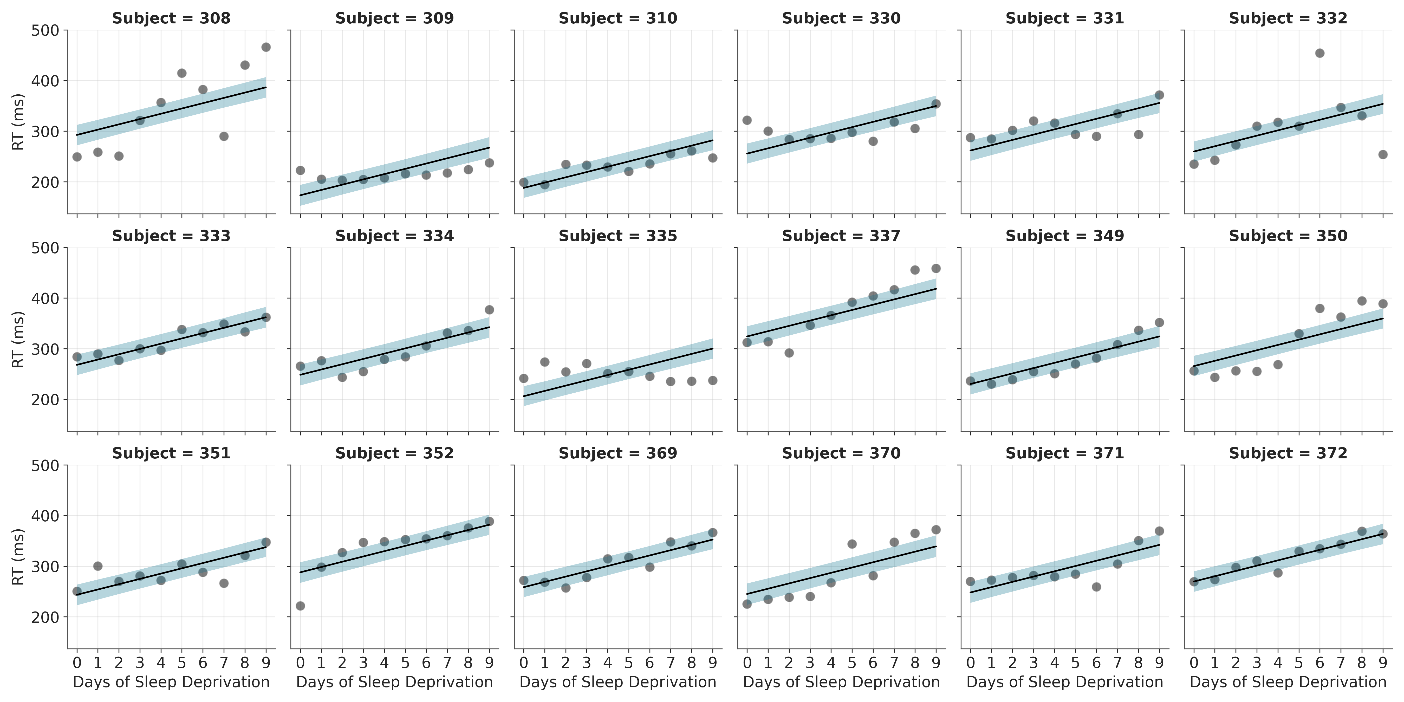
Option C₁ — Partial pooling: random intercept
Reaction ~ Days + (1|Subject)
A global intercept + an offset per person.
Slopes are still shared — everyone gets the same effect of Day.
Relaxes the assumption that everyone's baseline RT is the same, allowing for variation in baseline
Note the slope is the same, but the intercept is different – and confidence is even across

Slide 30
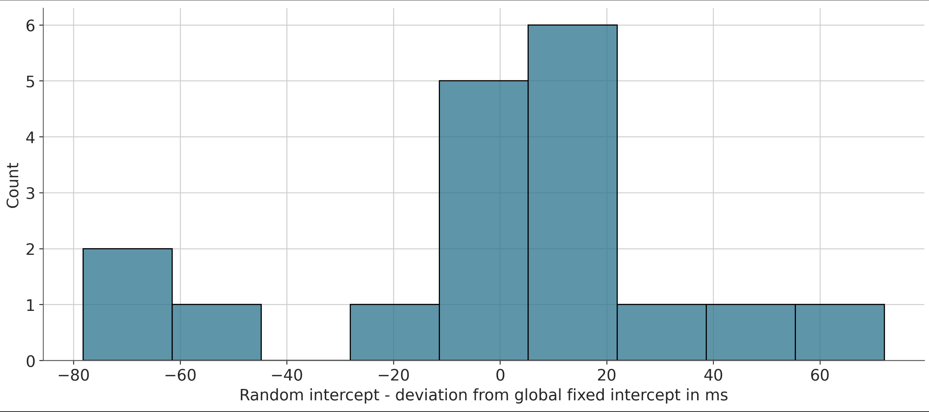
How does it work? — random intercepts as offsets
The model estimates one global intercept (≈ 251 ms) and a per-person offset.
Person i's intercept = 251 + offset_i.
The offsets have an SD of about 40 ms — this is information you never get from the GLM.
It tells you how much people genuinely differ at baseline!
No more "everyone has the same intercept" assumption.

Slide 31
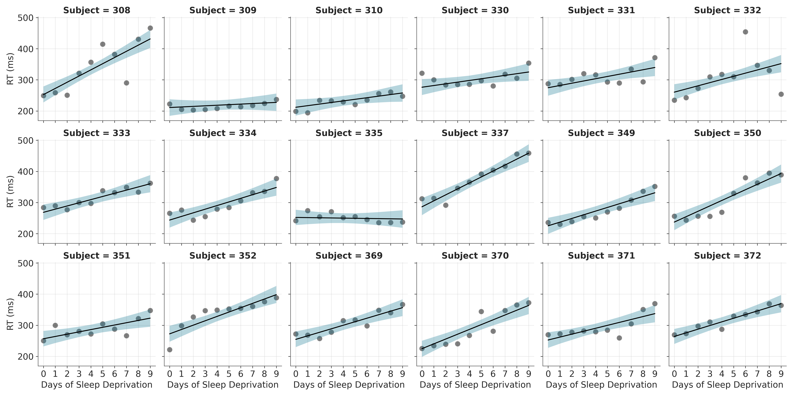
Option C₂ — Adding a random slope for Days
Reaction ~ Days + (Days|Subject)
Now the slope of Day can vary across people too.
Some are robust to sleep loss! But some collapse quickly.
The model captures both, without ever fitting them separately

Slide 32
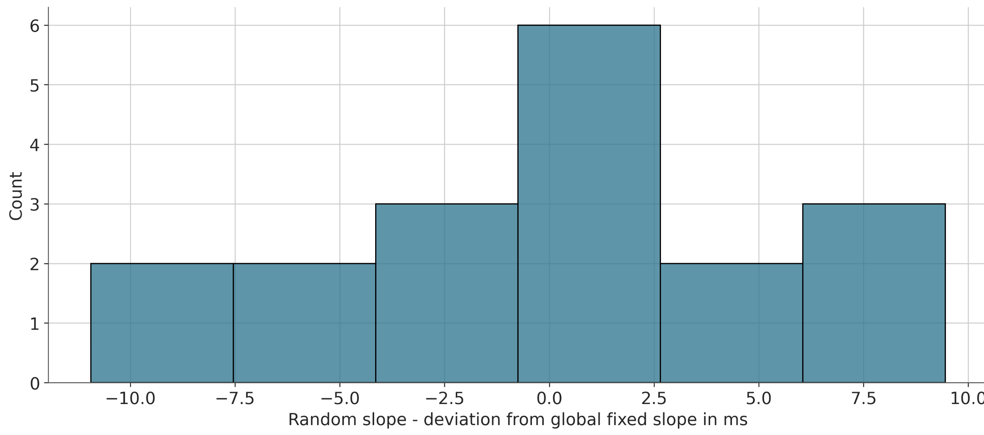
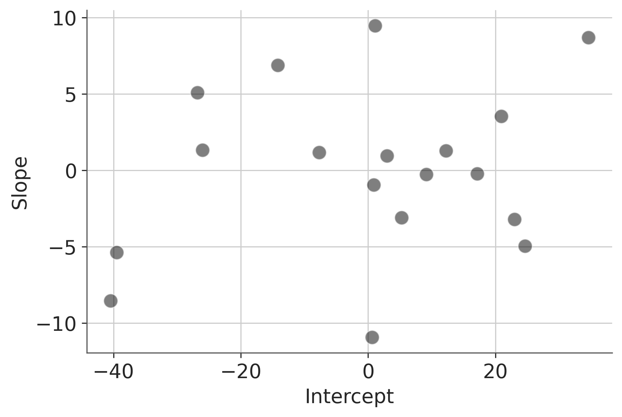
Two new pieces of information — for free
Left: random slopes — SD ≈ 6.5 ms/day of variation in how strongly sleep loss affects people.
Right: intercept × slope correlation — the model estimates whether slow starters tend to get worse faster. Here r = 0.2, modest positive association

Slide 33
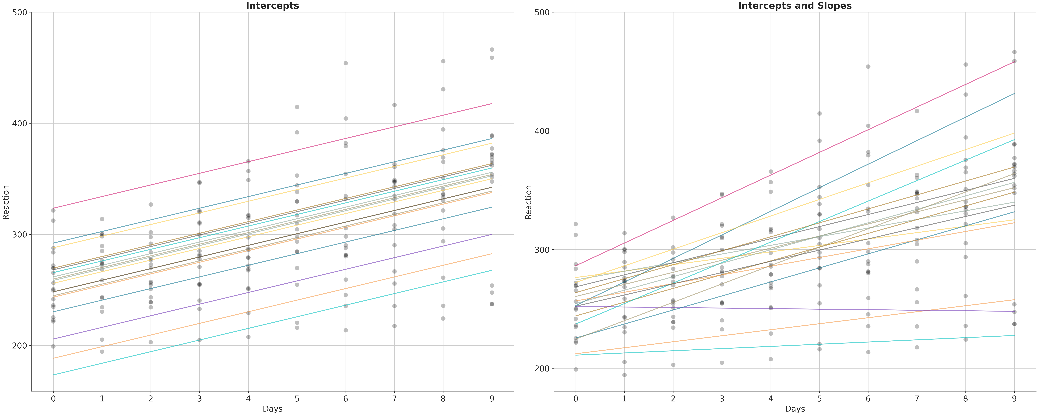
A different view of the same model

Slide 34
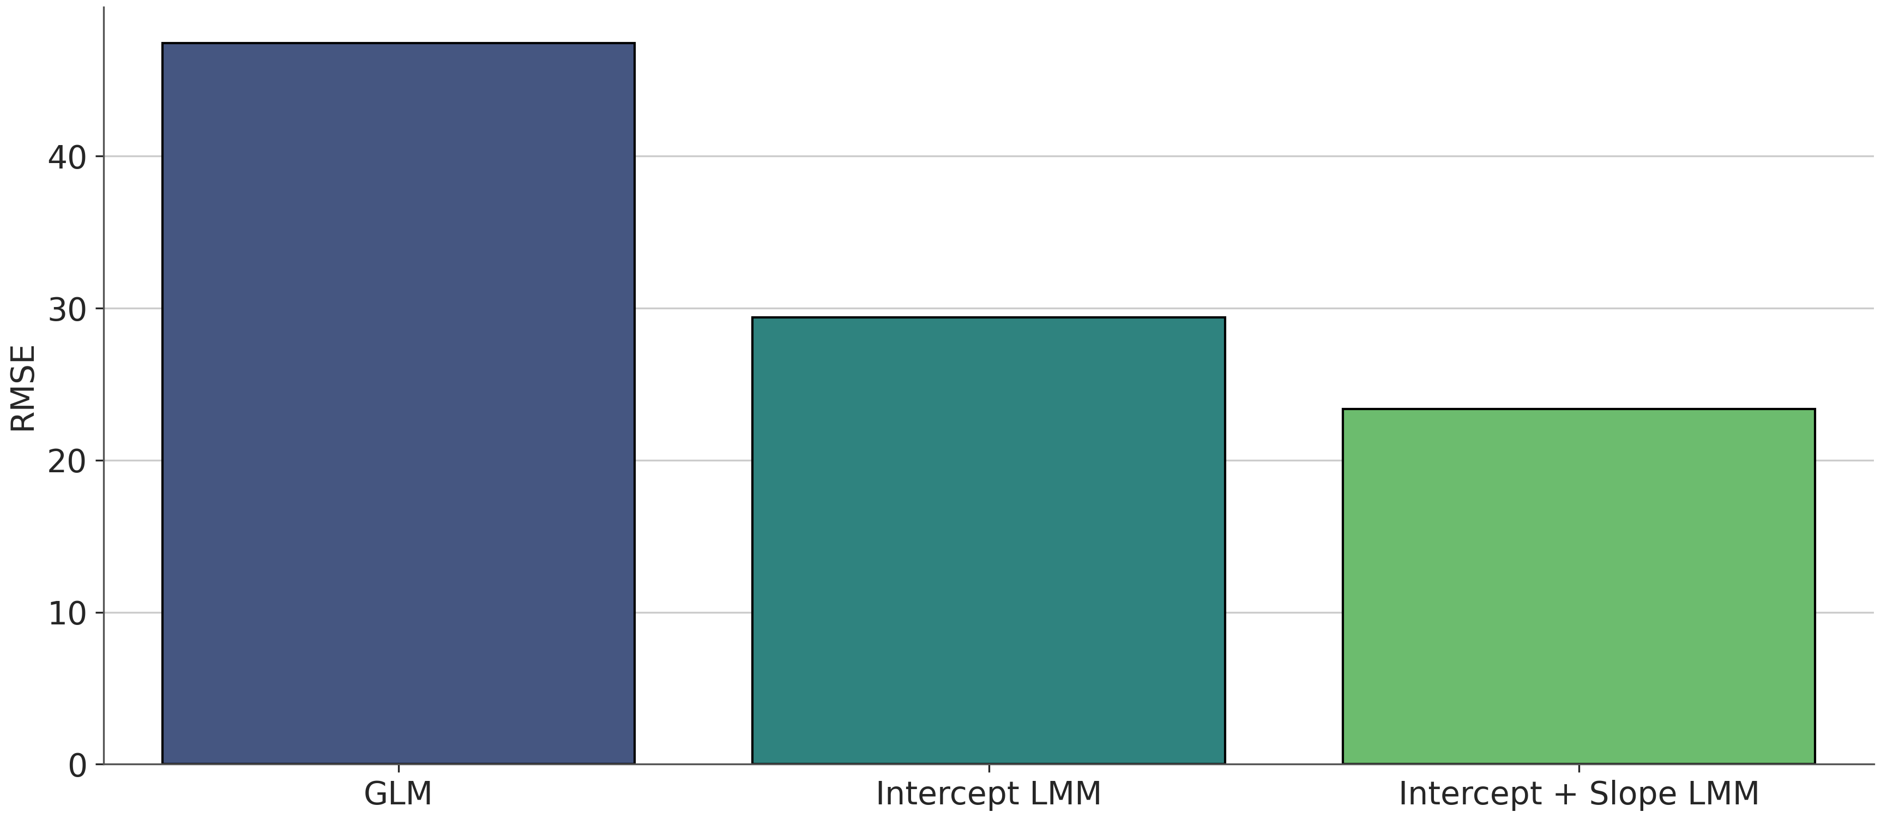
How much better is the mixed model?

Slide 35
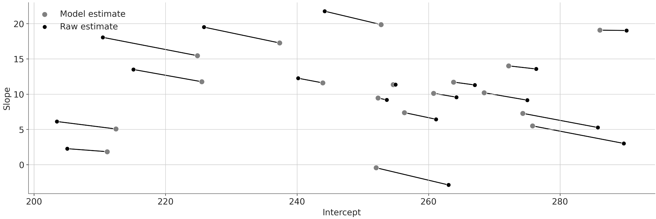
Partial pooling — information flows both ways
Each person's estimates are pulled toward the population mean —
but how much depends on how much data that person has, and how variable people are.
• People with lots of data move only slightly
• People with little data are shrunk toward the average
And it goes the other way too: the population estimate uses every observation, weighted appropriately

Slide 36
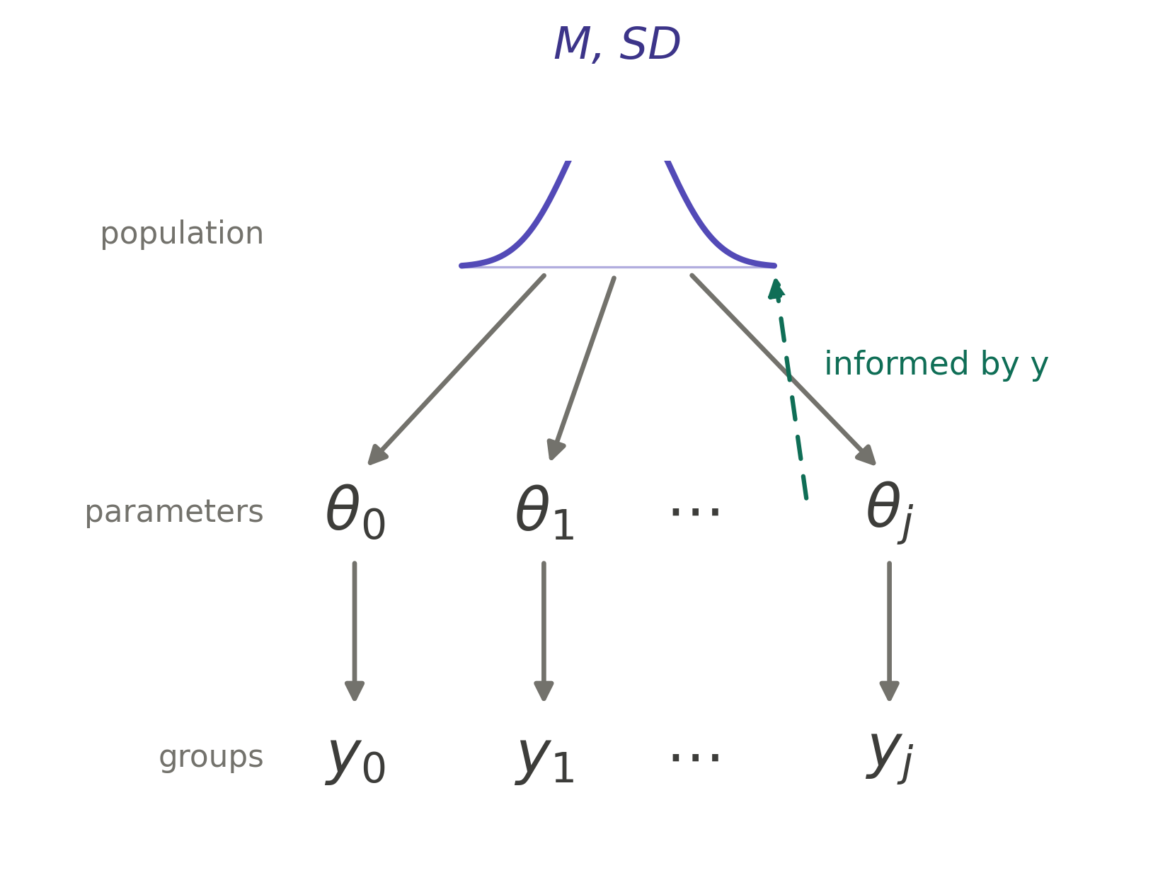
Philosophy of science — nomothetic & idiographic
Nomothetic
Effects exist in averages.
The historical mainstay of experimental psychology.
Tools: ANOVA, regression, group-level p-values.
Mixed models do both at once!
Idiographic
Effects live in individuals.
The psychometric and clinical tradition.
Tools: individual difference scores, case studies.

Slide 37
Part 3 — Issues to be aware of
Fixed vs random, model structure, effect sizes, power, and interpretations

Slide 38
What counts as a fixed effect or a random effect?
Rules of thumb — useful, not gospel.
Treat as FIXED if…
Treat as RANDOM if…
• You care about each specific level
• Levels are not exchangeable (e.g. drug doses – this one is key!)
• Few levels (commonly < 5)
• You'd like a coefficient and a p-value for each
• Levels are exchangeable samples from a larger population – nothing special about each level bar its name
• You care about variation across levels, not each level
• Many levels (subjects, stimuli, schools…)
• You want the structure of the data respected

Slide 39



Choosing a random effects structure
Perhaps the trickiest part of using these models – they can be mis-specified and things can go quietly wrong!
Two schools of thought
Basic tenet is to put random effects on anything that will support it
Failing to do so – when the effects do vary in the data – inflates your Type I error rate
Think very hard about what you want to test and specify your model accordingly
Start maximal and prune – anything non-identified is worthless, and even then ensure your random effects contribute meaningful information via model comparison
Problems
We don’t usually know if the effects do vary in the data
Adding in all the random effects can induce a severe problem – the convergence warning – you cannot trust the results!
Problems
Think very hard
The temptation: include every possible random slope ("keep it maximal")
The reality: maximal models often fail to converge, especially with modest data.
A pragmatic recipe:
1. Random intercepts for every grouping factor (subjects, items, schools…).
2. Random slopes for predictors that vary within those groups.
3. Add complexity only if the simpler model can't capture what you care about.
Convergence warnings are real — listen to them.
Singular fits mean the data does not support that structure. Don't ignore the warning, simplify.

Slide 40
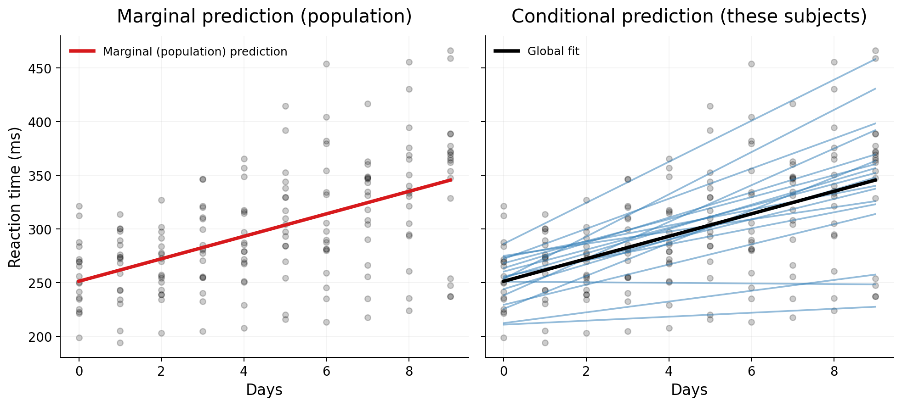
Effect sizes — marginal vs conditional R²
Marginal R² — variance explained by the fixed effects alone (the 'average person' prediction).
Conditional R² — variance explained by fixed + random effects together (the 'these specific subjects' prediction).
On the sleep study: marginal 0.28, conditional 0.80
The first can be useful for out-of-sample data (i.e. generalisation), while the second is more descriptive about the existing sample

Slide 41
Coefficients — query the model, don't read the table
Once you have interactions, polynomials, or many random effects, the coefficient table becomes unreadable.
Don't read it. Use the model to make predictions for the scenarios you care about.
• 'What is the predicted RT on day 0 for an average person?' → marginal prediction.
• 'What is the predicted RT trajectory for subject 308?' → conditional prediction.
• 'What is the difference in slope between conditions A and B?' → contrast of predictions.
In JAMOVI: GAMLj's Estimated Marginal Means panel

Slide 42
Power analysis — there is no G*Power for this
Power in mixed models depends on:
• the number of clusters
• the number of observations per cluster
• the size of the random-effect variances
• the design (within vs between)
Adding 1000 more trials per person buys you very little power for between-subject effects.
Adding 20 more participants might buy a lot. The opposite is true for within-subject effects.
There is no closed-form formula. The honest approach is simulation —
fit the model you'd run, on data you generate from realistic parameters, many times.
Count how often the effect of interest is recovered.
Most precise pre-registered power analyses for mixed models are fictional, and most don’t attempt one!

Slide 43
Recap
1. Almost all standard statistics in psychology is the GLM.
2. We are wary of the independence assumption, so contort data into standard approaches
3. The linear mixed model is the GLM with random effects added —
one extra ingredient that respects clustered data.
4. Partial pooling gives you population estimates AND individual estimates,
with information flowing in both directions.
5. Costs: thoughtful model building, harder interpretation, harder power.
All worth it, for a model that actually matches your data.

Slide 44
Notes on random effects and their structure
You will see these discussed in papers on occasion!
Nested: classes within schools — (1|school/class). Each lower unit sits inside one higher unit.
Crossed: every rater sees every face — (1|rater) + (1|face). Neither nests in the other.
Most experiments are crossed: participants × items (faces, words, scenes, trials).
Treating your stimuli as fixed — or averaging over them — assumes your specific items are the population. They're a sample. Ignoring their variance inflates false positives, often badly (Judd, Westfall & Kenny, 2012).
Rule of thumb: if you'd want the finding to hold for other faces, faces get a random effect.

Slide 45
After lunch — JAMOVI
We'll use the GAMLj module in JAMOVI to fit the same models we've just discussed
By the end of the day, you should be able to fit, interpret, and report a linear mixed model.

Slide 46
Questions?

